Slide 1
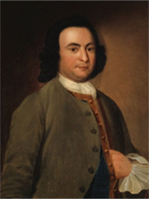
George Mason
Anti-Federalists, Federalists, The Federalist Papers and the Bill of Rights
1.06 Compare viewpoints about government in the Federalist and the Anti-Federalist Papers.
1.07 Evaluate the extent to which the Bill of Rights extended the Constitution.
Notes:
1SS-E17. Describe the aspirations, ideals, and events that served as the foundation for the creation of a new national government, with emphasis on:
PO 4. Struggles over ratification of the Constitution and the creation of the Bill of Rights

Slide 2
After the Constitution was signed on September 17, 1787, the fight for Ratification began.
9 out of 13 states had to ratify the Constitution before it would go into effect.
Two factions (opposing groups) emerged:
Federalists who supported the Constitution
Anti-Federalists who opposed to the Constitution
These two groups argued for their position in newspapers, magazines, and pamphlets until the Constitution was ratified by the 9th and decisive state on June 21, 1788
Notes:
1SS-E17. Describe the aspirations, ideals, and events that served as the foundation for the creation of a new national government, with emphasis on:
PO 4. Struggles over ratification of the Constitution and the creation of the Bill of Rights

Slide 3
5. Ideology of Factions
Federalists | Anti-Federalists
Supported removing some powers from the states and giving more power to the national government.
Wanted important political powers to remain with the states.
Favored dividing powers among different branches of government.
Wanted the legislative branch to have more power than an executive.
Proposed a single person to lead the executive branch.
Feared that a strong executive might become a king or tyrant.
Believed Constitution did not need a Bill of Rights
Wanted a Bill of Rights added to the Constitution
Notes:
1SS-E17. Describe the aspirations, ideals, and events that served as the foundation for the creation of a new national government, with emphasis on:
PO 4. Struggles over ratification of the Constitution and the creation of the Bill of Rights

Slide 4
Anti-Federalists
Led by Thomas Jefferson and included farmers and small landowners who believed nation’s future rested on agriculture.
Arguments made by Anti-Federalists
The Constitutional Convention went beyond what they were charged to do. (illegal-Treason)
A strong national government would destroy states’ rights.
Resembled a monarchy with its concentration of power
Did not have a Bill of Rights
Notes:
1SS-E17. Describe the aspirations, ideals, and events that served as the foundation for the creation of a new national government, with emphasis on:
PO 4. Struggles over ratification of the Constitution and the creation of the Bill of Rights

Slide 5
Federalists
Argued that the new nation needed an effective national government to handle the nation’s economy, establish its monetary system, promote justice, and protect individual liberty.
Took name “Federalists” show link to “Federalism”
Federalism: government power is distributed among the states, but the power of the central authority outweighs the authority of the states.
Included Alexander Hamilton, George Washington, Benjamin Franklin, and James Madison.
Wrote a series of letters/essays called the Federalist papers in support of the new constitution.
Notes:
1SS-E17. Describe the aspirations, ideals, and events that served as the foundation for the creation of a new national government, with emphasis on:
PO 4. Struggles over ratification of the Constitution and the creation of the Bill of Rights

Slide 6
The Federalist Papers
Written by Alexander Hamilton, James Madison and John way under pen name Publius (Latin word for public).
A series of letters published in newspapers
Written for three reasons:
To influence the vote in favor of ratification
To explain the Constitution for future interpretation
Outlined how the Constitution should be set up
Included 85 letters published from October 1787 to April 1788 and later bound in book form.
Notes:
1SS-E17. Describe the aspirations, ideals, and events that served as the foundation for the creation of a new national government, with emphasis on:
PO 4. Struggles over ratification of the Constitution and the creation of the Bill of Rights

Slide 7
The Federalist Papers
Arguments made by The Federalist Papers
Federalists 1-14 stressed importance of the Union
Federalists’ 15-22 stressed inadequacy of the Articles of confederation
Federalists 23-36 Explained arguments for the Type of Government Contained in the Constitution
Federalists 37-51 Explained the Republican Form of Government
Federalists 52-83 explained the 3 branches of government.
Federalists 84-85 answers questions of objections to the Constitution
Notes:
1SS-E17. Describe the aspirations, ideals, and events that served as the foundation for the creation of a new national government, with emphasis on:
PO 4. Struggles over ratification of the Constitution and the creation of the Bill of Rights

Slide 8
Ratification
In the spirit of Compromise, the Federalists agreed to add a Bill of Rights which helped the document to be ratified.
Delaware was the first state to ratify the document on December 7, 1787.
New Hampshire was the 9th and decisive state.
North Carolina became the 12th state to ratify the Constitution whey they approved the document on November 21, 1789. Rhode Island was the last to ratify in 1790.
Once the document was ratified questions arose on how to put the Constitution into practice leading to the growth of political parties.
Notes:
1SS-E17. Describe the aspirations, ideals, and events that served as the foundation for the creation of a new national government, with emphasis on:
PO 4. Struggles over ratification of the Constitution and the creation of the Bill of Rights

Slide 9
A.
Led by George Washington and Alexander Hamilton
Believed in a strong central government
Supported loose interpretation of the constitution.
Believed future of country rested on manufacturing and industry.
Notes:
1SS-E18. Describe the actions taken to build one nation from thirteen states, with emphasis on:
PO 3. the creation of political parties, including the ideals of the Democratic Republicans and the Federalists

Slide 10
B.
Led by Thomas Jefferson and James Madison
Believed in states’ rights
Wanted strict interpretation of the Constitution
Believed that the future of the nation rested with agriculture.
Notes:
1SS-E18. Describe the actions taken to build one nation from thirteen states, with emphasis on:
PO 3. the creation of political parties, including the ideals of the Democratic Republicans and the Federalists

Slide 11
The Bill of Rights was the first test of the amendment process outlined in Article 5 of the Constitution.
The Articles lays out two ways to amend a document.
2/3rd of both houses, or Conventions in 2/3rd of the states propose an amendment
3/4th of state legislatures or special conventions in each state ratifies the amendment
10 of 12 proposed amendments were ratified on December 15, 1791.
Notes:
1SS-E17. Describe the aspirations, ideals, and events that served as the foundation for the creation of a new national government, with emphasis on:
PO 4. Struggles over ratification of the Constitution and the creation of the Bill of Rights

Slide 12
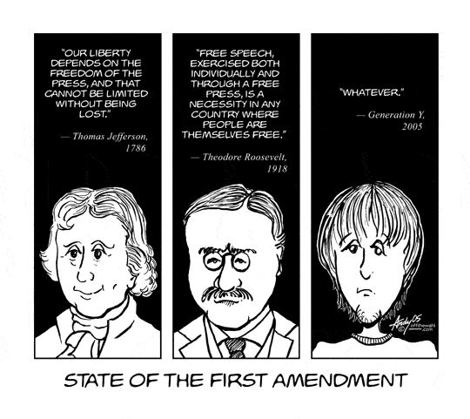
Amendments
1st Amendment: 5 Freedoms – religion, assembly, petition, press, and speech.
Establishment Clause: government can not establish a state religion.
Free exercise Clause: citizens can worship (or not) any way they choose.
Notes:
1SS-E17. Describe the aspirations, ideals, and events that served as the foundation for the creation of a new national government, with emphasis on:
PO 4. Struggles over ratification of the Constitution and the creation of the Bill of Rights

Slide 13
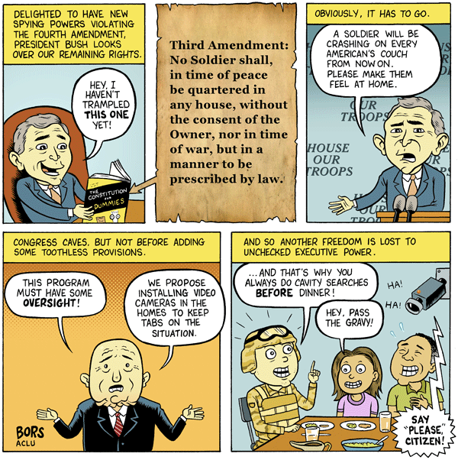
2nd Amendment: right to bear arms.
3rd Amendment: government can’t ask you to quarter soldiers.
Notes:
1SS-E17. Describe the aspirations, ideals, and events that served as the foundation for the creation of a new national government, with emphasis on:
PO 4. Struggles over ratification of the Constitution and the creation of the Bill of Rights

Slide 14
4th Amendment: protection against search and seizure
Police need search warrant or probable cause
5th Amendment: due process of law, right to remain silent, indictment by a grand jury, double jeopardy, and eminent domain (rights of person’s accused of a crime)
Notes:
1SS-E17. Describe the aspirations, ideals, and events that served as the foundation for the creation of a new national government, with emphasis on:
PO 4. Struggles over ratification of the Constitution and the creation of the Bill of Rights

Slide 15
6th Amendment: right to a speedy, fair, and public trial of your peers, right to a lawyer/attorney/ counsel, right to confront witnesses, right to bring witnesses to testify on your behalf. (more rights of the accused)
Notes:
1SS-E17. Describe the aspirations, ideals, and events that served as the foundation for the creation of a new national government, with emphasis on:
PO 4. Struggles over ratification of the Constitution and the creation of the Bill of Rights

Slide 16
7th Amendment: right to a jury trial in civil cases more than $20.00.
8th Amendment: right to apply for bail, no cruel or unusual punishment
Notes:
1SS-E17. Describe the aspirations, ideals, and events that served as the foundation for the creation of a new national government, with emphasis on:
PO 4. Struggles over ratification of the Constitution and the creation of the Bill of Rights

Slide 17
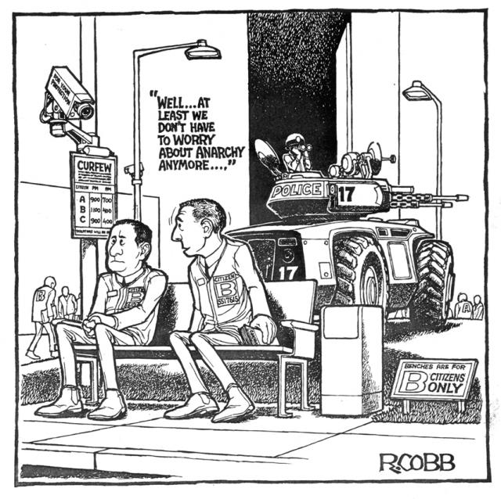
9th Amendment: All powers not listed in the constitution belong to the people.
10th Amendment: All powers not listed in Constitution belong to states or the people.
Notes:
1SS-E17. Describe the aspirations, ideals, and events that served as the foundation for the creation of a new national government, with emphasis on:
PO 4. Struggles over ratification of the Constitution and the creation of the Bill of Rights

Slide 18
